Slide 1
Potential Energy

Slide 2

By the end of this lesson, you should be able to do the following:
Identify and describe the three types of potential energy.
Distinguish potential energy from kinetic energy.

Slide 3
Potential energy is also known as stored energy, because it is stored in objects.
Lots of things have potential energy!
For example, your phone and laptop have batteries that store energy for the devices to use. Food has potential energy that we take when we eat it.

Slide 4

Your food and drink are turned into energy when you eat, and the energy is stored in your body.
The energy is used when you produce kinetic energy - moving, or speaking, or just warming yourself up.

Slide 5
There are three main types of potential energy:
Chemical potential energy, which is stored in the chemical bonds between atoms.
Elastic potential energy, which is stored in stretchable materials (such as springs).
Gravitational potential energy, which is stored in objects that are experiencing gravity.

Slide 6

An object that is experiencing gravity has gravitational potential energy (GPE).
Every object on the Earth has GPE, because everything is attracted to the Earth's centre.
This energy is converted into kinetic energy when an object moves downwards.

Slide 7

Say you push a boulder off a cliff. At the top of the cliff, it has a certain amount of gravitational potential energy.
When it falls off, that potential energy decreases as the boulder speeds up, and the GPE converts to kinetic energy. At the bottom, the boulder stops. The boulder has less gravitational potential energy than it did at the top of the cliff.

Slide 8

The gravitational potential energy (GPE) of an object depends on its mass and its height above the ground.
This means that larger and higher objects have more energy to fall with than those that are smaller or closer to the ground.

Slide 9
Gravitational potential energy (GPE) is the energy associated with the height of an object above the ground.
It is defined as the energy stored in an object as a result of its position relative to another object to which it is attracted by the force of gravity.

Slide 10


Slide 11
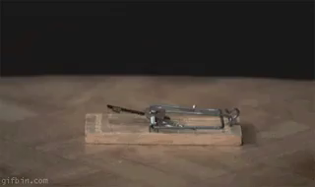
Some objects can be stretched. When they are stretched, energy is put into the object and stored as potential energy.
It is then released as kinetic energy when the object is returned to its usual form.
This is elastic potential energy.

Slide 12
Elastic potential energy is the energy stored in an elastic material or spring when compressed or extended.

Slide 13
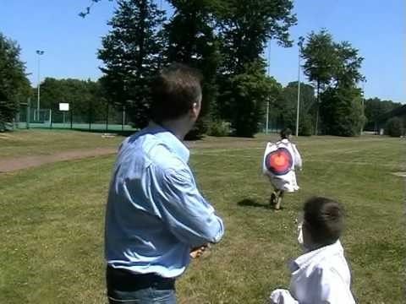

Slide 14
Chemical potential energy is the energy stored within objects, created when atoms and molecules bond.
Chemical bonds are like the glue which holds particles together, and each bond contains a lot of energy.

Slide 15
